Slide 1
Insights from Data
Opening lecture
Elaheh Moradi
elaheh.moradi@uef.fi
21.10.2024

Slide 2
Welcome to Insights from Data
Course information
Course contents
Introduction to data science
R and Rstudio

Slide 3
Welcome to the course
The primary information channel is the Moodle page of the course at https://elearn.uef.fi/course/view.php?id=9777
https://elearn.uef.fi/course/view.php?id=9778
The lectures are online (except for three sessions) through the Zoom
Course Material: The main material for this course is the lecture slides, which will be made available on Moodle at the end of each week.
See details in Moodle

Slide 4
Course Overview
Goals:
Introduce the fundamentals of data analysis.
Equip students with the essential skills to analyze, interpret, and visualize data using the R programming language.
Provide a foundational understanding for those interested in pursuing a career in data science or related fields. This course serves as starting point to more advanced topics.
Outcomes:
Gain hands-on experience in data analysis, visualization, and presentation.
Develop practical skills in interpreting and deriving meaningful insights from complex datasets
Build a strong foundation for further studies or professional work in data science and related fields.
Acquire the ability to present data-driven findings effectively

Slide 5
Lectures and Exercises
Lectures: Thursdays from 14:00 to 16:00, Fridays from 12:00 to 14:00
Exercise sessions: Fridays 14:00-16:00
Exceptions:
21.10.2024: Opening lecture from 10:00 to 12:00 via Zoom.
On-site sessions
Week 44:
Lectures: Tuesday 8:00-10:00 and Thursday 12:00-14:00
Exercise: Thursday 14:00-16:00
Week 48:
Lectures: Wednesday 12:00-14:00 and Thursday 14:00-16:00
Exercise: Wednesday 14:00-16:00

Slide 6
On-site Sessions
Week 43:
Thursday (24.10) from 10:00 to 14:00, E24+25 (Kuopio)
Friday (25.10) from 10:00 to 14:00, M104 (Joensuu)
Week 46:
Thursday (14.11) from 10:00 to 14:00, E24+25 (Kuopio)
Friday (15.11) from 12:00 to 16:00, M104 (Joensuu)
Week 49:
Tuesday (3.12) from 10:00 to 16:00, M104(Joensuu)
Wednesday (4.12) from 10:00 to 16:00, E24+25 (Kuopio)

Slide 7
Assessment and Final Grade
Final grade will be determined based on three assignments and a final presentation
Project work 1: 20%
Project work 2: 30%
Project work 3: 50% (30% for the project work and 20% for the presentation). Furthermore, an additional credit can be earned by completing an extra task in the final project.

Slide 8
Project Works
Three Project Works: These project works are equivalent in scope to extended weekly exercises.
Detailed Reports: You will be required to submit a comprehensive report for each project, detailing your methodology, analysis, and result interpretation.
Moodle Posting: Each project will be made available on Moodle at least 2 weeks before the deadline.
Final Project Presentation: A five-minute presentation for the final project work.

Slide 9
Course Completion Requirements
To complete the course, you must fulfill the following mandatory requirements:
Complete at least 40% of the exercises.
Submit three project assignments.
Deliver a presentation for the final project.
This is a 4+1 credits course

Slide 10
Course contents
Introduction to Data Science and R
Data Preprocessing and Cleaning
Data Visualization with ggplot2
Exploratory Data Analysis
Clustering for Pattern Discovery
Introduction to Statistical Analysis

Slide 11
Introduction to Data Science

Slide 12
Data Science
Gaining insights from data through computational analysis

Slide 13
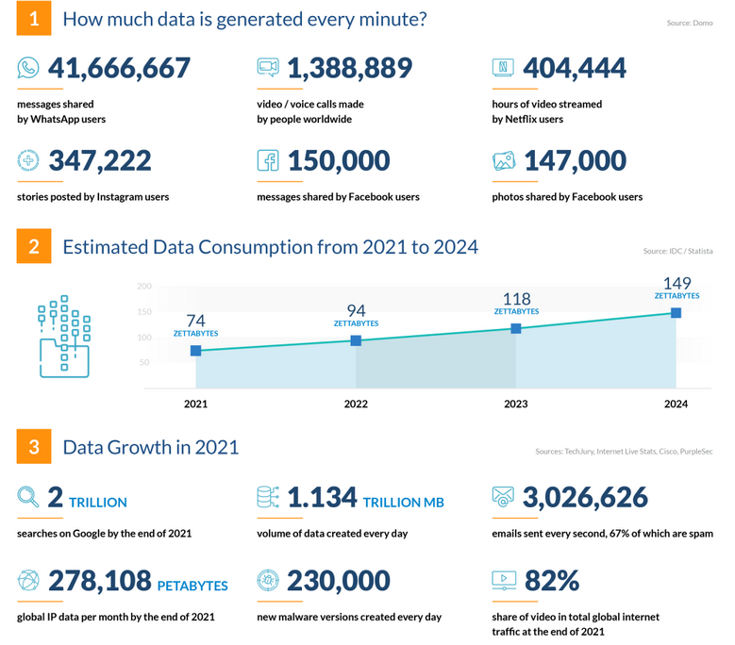
Why Data Science?
Image from: https://financesonline.com/how-much-data-is-created-every-day/

Slide 14
Top programming languages for data scientists in 2023
Python
R
SQL
Java
Julia
Scala
C/C++
JavaScript
Swift
Go
MATLAB
SAS
Link: Top programming languages for data scientists in 2023
Python and R are the preferred languages in Data Science Data Analysis, Machine Learning, etc.

Slide 15
R vs. Python
Python:
widely used in web development, automation, and data science, excellent for machine learning with strong libraries
Easy to learn for beginners, with a readable syntax.
Strong community and extensive resources across many fields.
R:
Tailored for statistical analysis and data visualization.
Contains a vast library of packages
Ideal for analytics in fields like bioinformatics, economics, and social sciences
Integrated well with data science-specific tasks like statistical modeling and exploratory data analysis.
https://medium.com/analytics-and-data/r-vs-python-a-comprehensive-guide-for-data-professionals-321e8dead598
https://www.dataquest.io/blog/python-vs-r/
https://posit.co/blog/r-vs-python-what-s-the-best-for-language-for-data-science/

Slide 16
Features of R Programming Language
R is built for statistics and data visualization, offering specialized tools for analyzing and interpreting data.
R has thousands of packages dedicated to data manipulation, visualization, and advanced data analysis
Data Manipulation and Data Visualization
Compatibility
Link: https://emeritus.org/in/learn/importance-of-r-in-data-science/

Slide 17
How to Install the R Program?
Installing R and RStudio
https://www.stat.colostate.edu/~jah/talks_public_html/isec2020/installRStudio.html

Slide 18
Next Steps
Next session on-site, Thursday (Kuopio) or Friday(Joensuu).
Attendance is important

